Slide 1

Data Preprocessing: Missing Value
Leighann Robinson
DS160 SP 23

Slide 2
Data Preprocessing
Data preprocessing – A part of the data analysis process that takes the raw data found and transforms it into a different format that is more easily understood for computers to conduct machine learning and analysis.
Data cleaning – the process of adding missing data and correcting or removing incorrect or unnecessary data from a data set.
Data cleaning is part of the preprocessing process
Correcting or removing missing values increases the quality of the data findings

Slide 3
Missing Values
Datasets that contain missing values do not showcase the entirety of the collected data.
Missing values within datasets can skew the findings, making the observed results not entirely factual.
The presence of missing values can be due to human error or incomplete data findings.
The process of imputing missing values helps to lessen the possibility of skewed data.

Slide 4
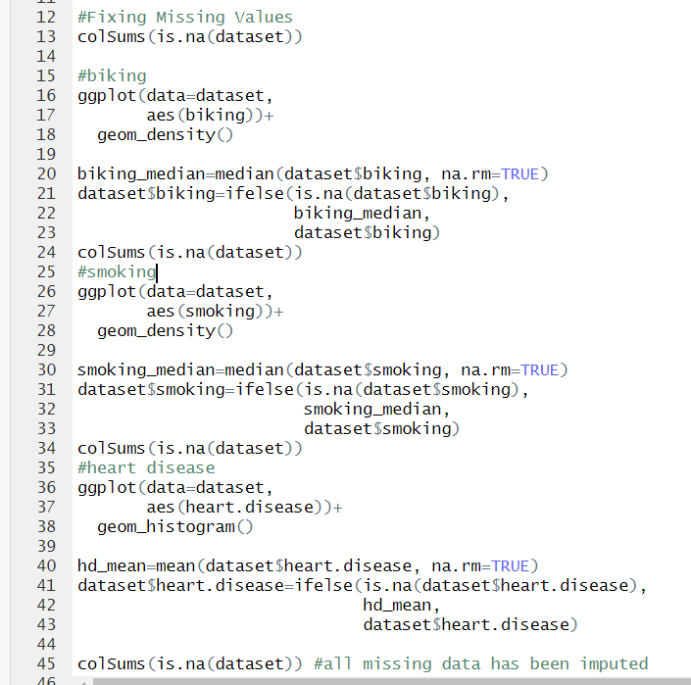
RStudio
In RStudio, missing values in datasets can be found using the code colSums(is.na())
The number of missing values will show in the console, along with what column they are from
Plot the dataset in either density plot or histogram
Impute mean/median accordingly using ifelse statement

Slide 5
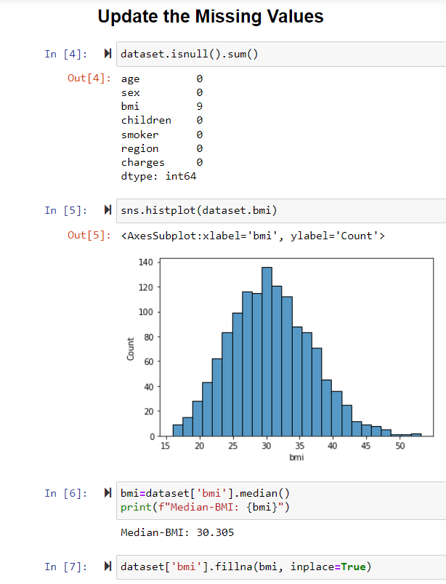
Python
Missing values can be checked in Python using a similar code to that in R
The function isnull.na() tells what data columns have missing values and how many
Plot the distribution using a histogram (Seaborn/Pandas)
fillna() function inputs the value found for mean/median into the dataset for any null values for that column

Slide 6
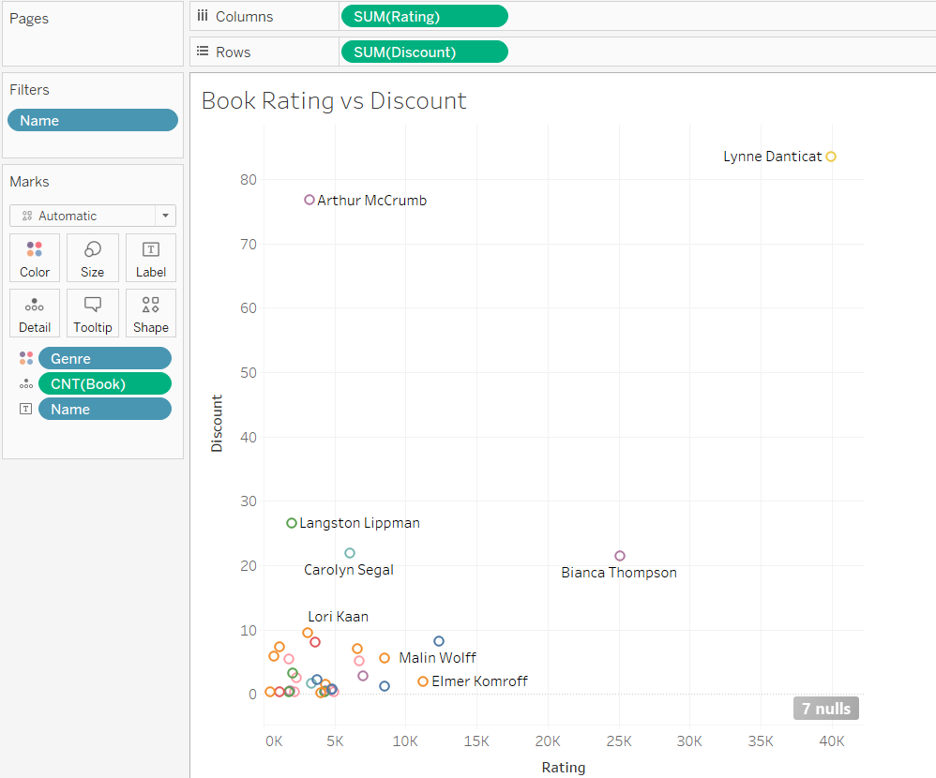
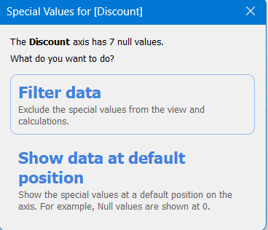
Tableau
Different than RStudio or Python
Can filter out missing values
Can display separately, or include in overall data visualization
Tableau allows uses to filter out null values using the filter option
Option to still include missing values

Slide 7
Questions?

